Slide 1
Medication Safety for Teens
Presenter Name/Organization
Notes:
Welcome to today’s program, “My Generation Rx: Medication Safety for Teens”. You may be asking yourself, “What is My Generation Rx?”
“My Generation Rx” encourages teens to incorporate the Generation Rx messages into their individual, everyday lives. These messages focus on preventing prescription drug misuse by talking with teens about how to safely use medications and how to turn down invitations to misuse, as well as identifying positive alternatives for coping with the demands of life.
Today, I’ll deliver an interactive presentation that discusses these messages.

Slide 2

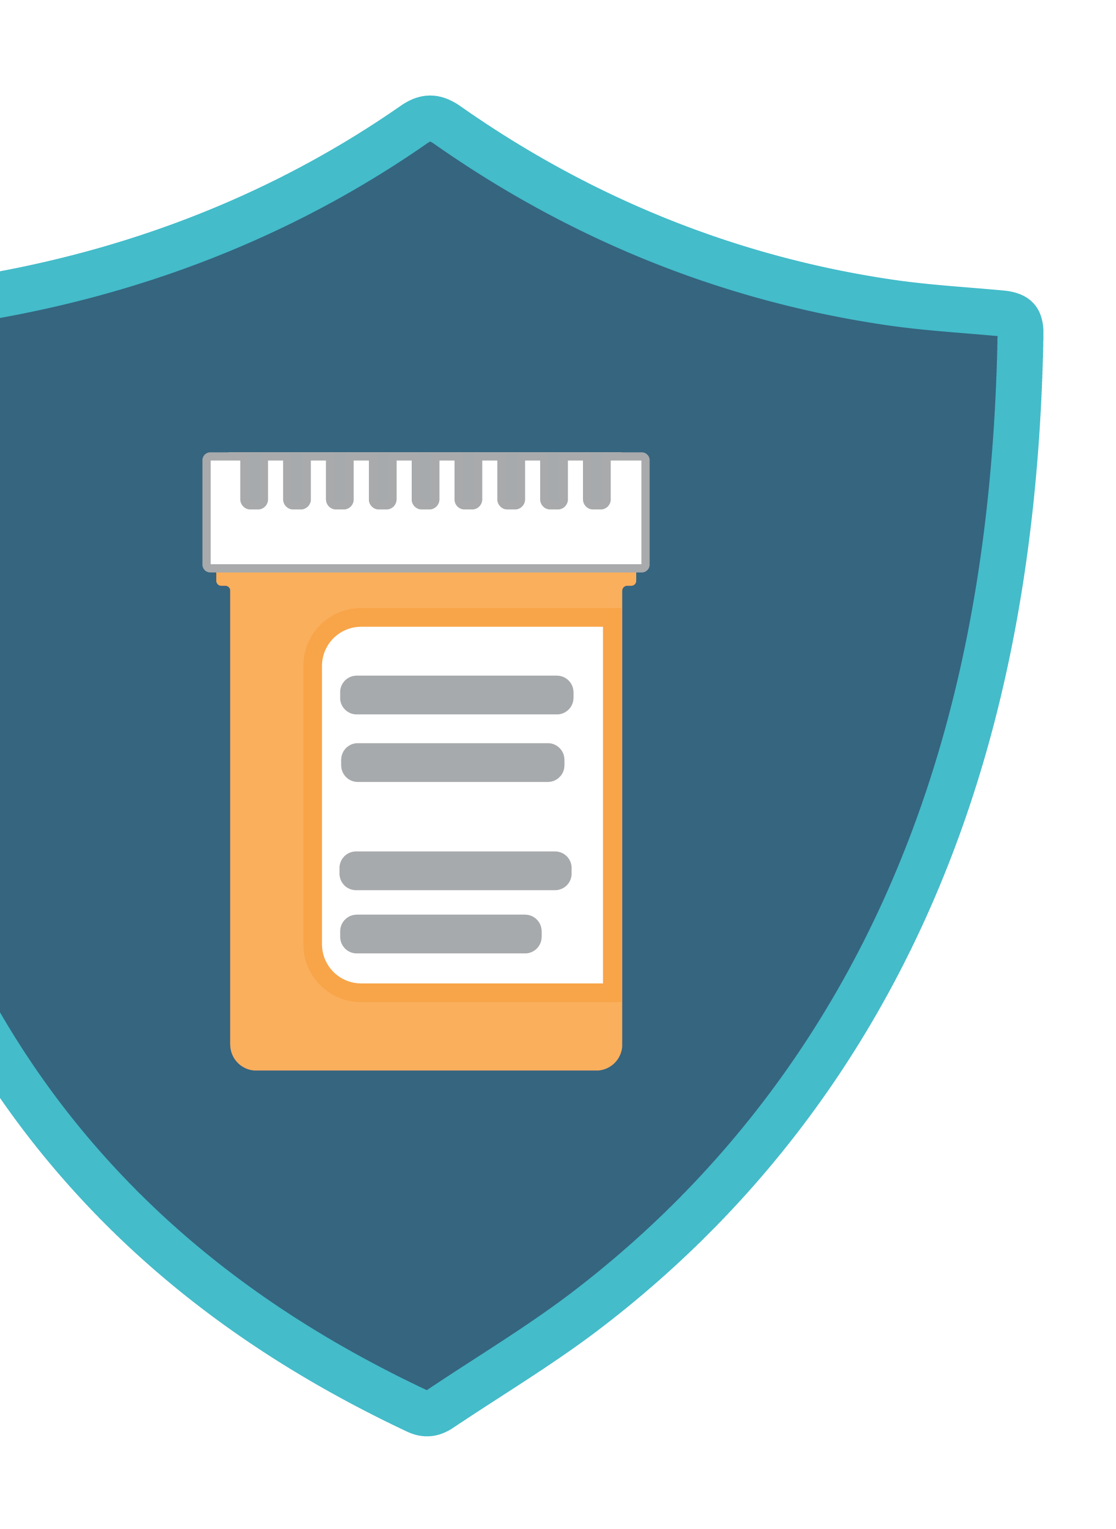
Medications can help us when used as directed by a healthcare professional
Notes:
Let’s begin by establishing the beneficial impact of prescription medications.
Prescription medications can help us lead longer and healthier lives when used under the supervision of a healthcare professional, like a pharmacist or doctor.
Our life expectancy is the longest in history, and people are now able to live with many diseases that were once fatal.
We are preventing or curing many illnesses and relieving troublesome symptoms, in part, because of prescription medications.
Transition: Medications can help us, but only when used as directed by a healthcare professional. Medications can be harmful, especially when misused.

Slide 3

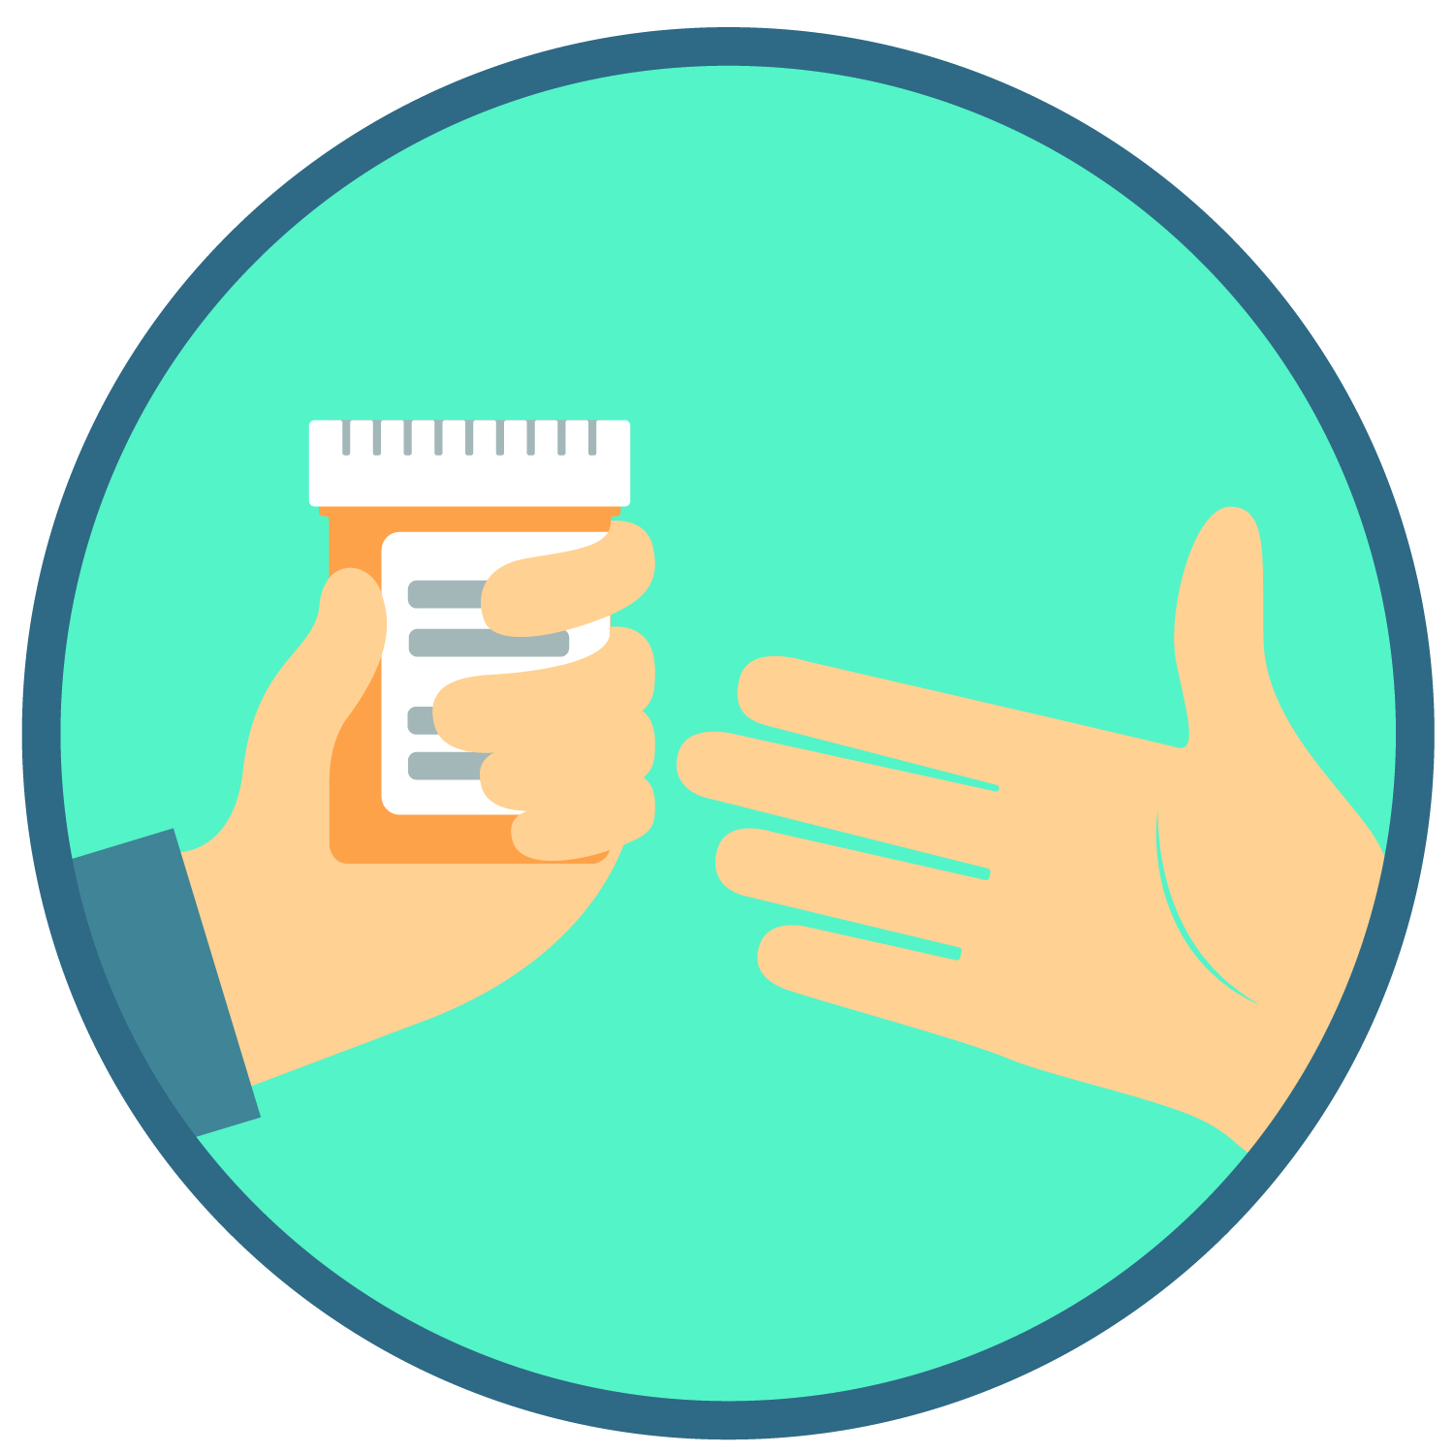
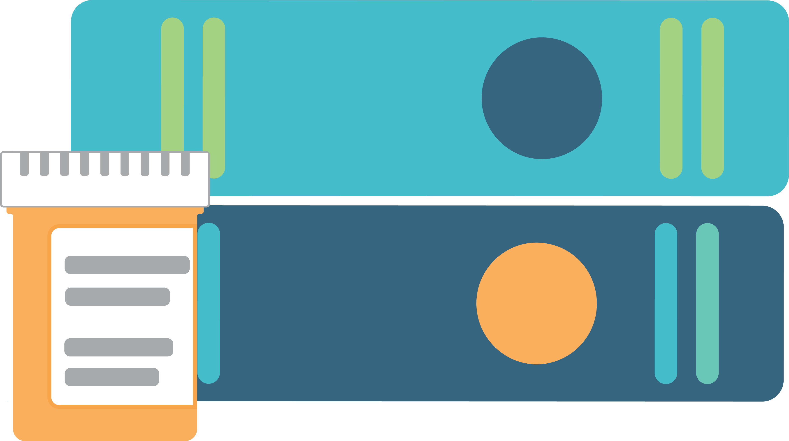
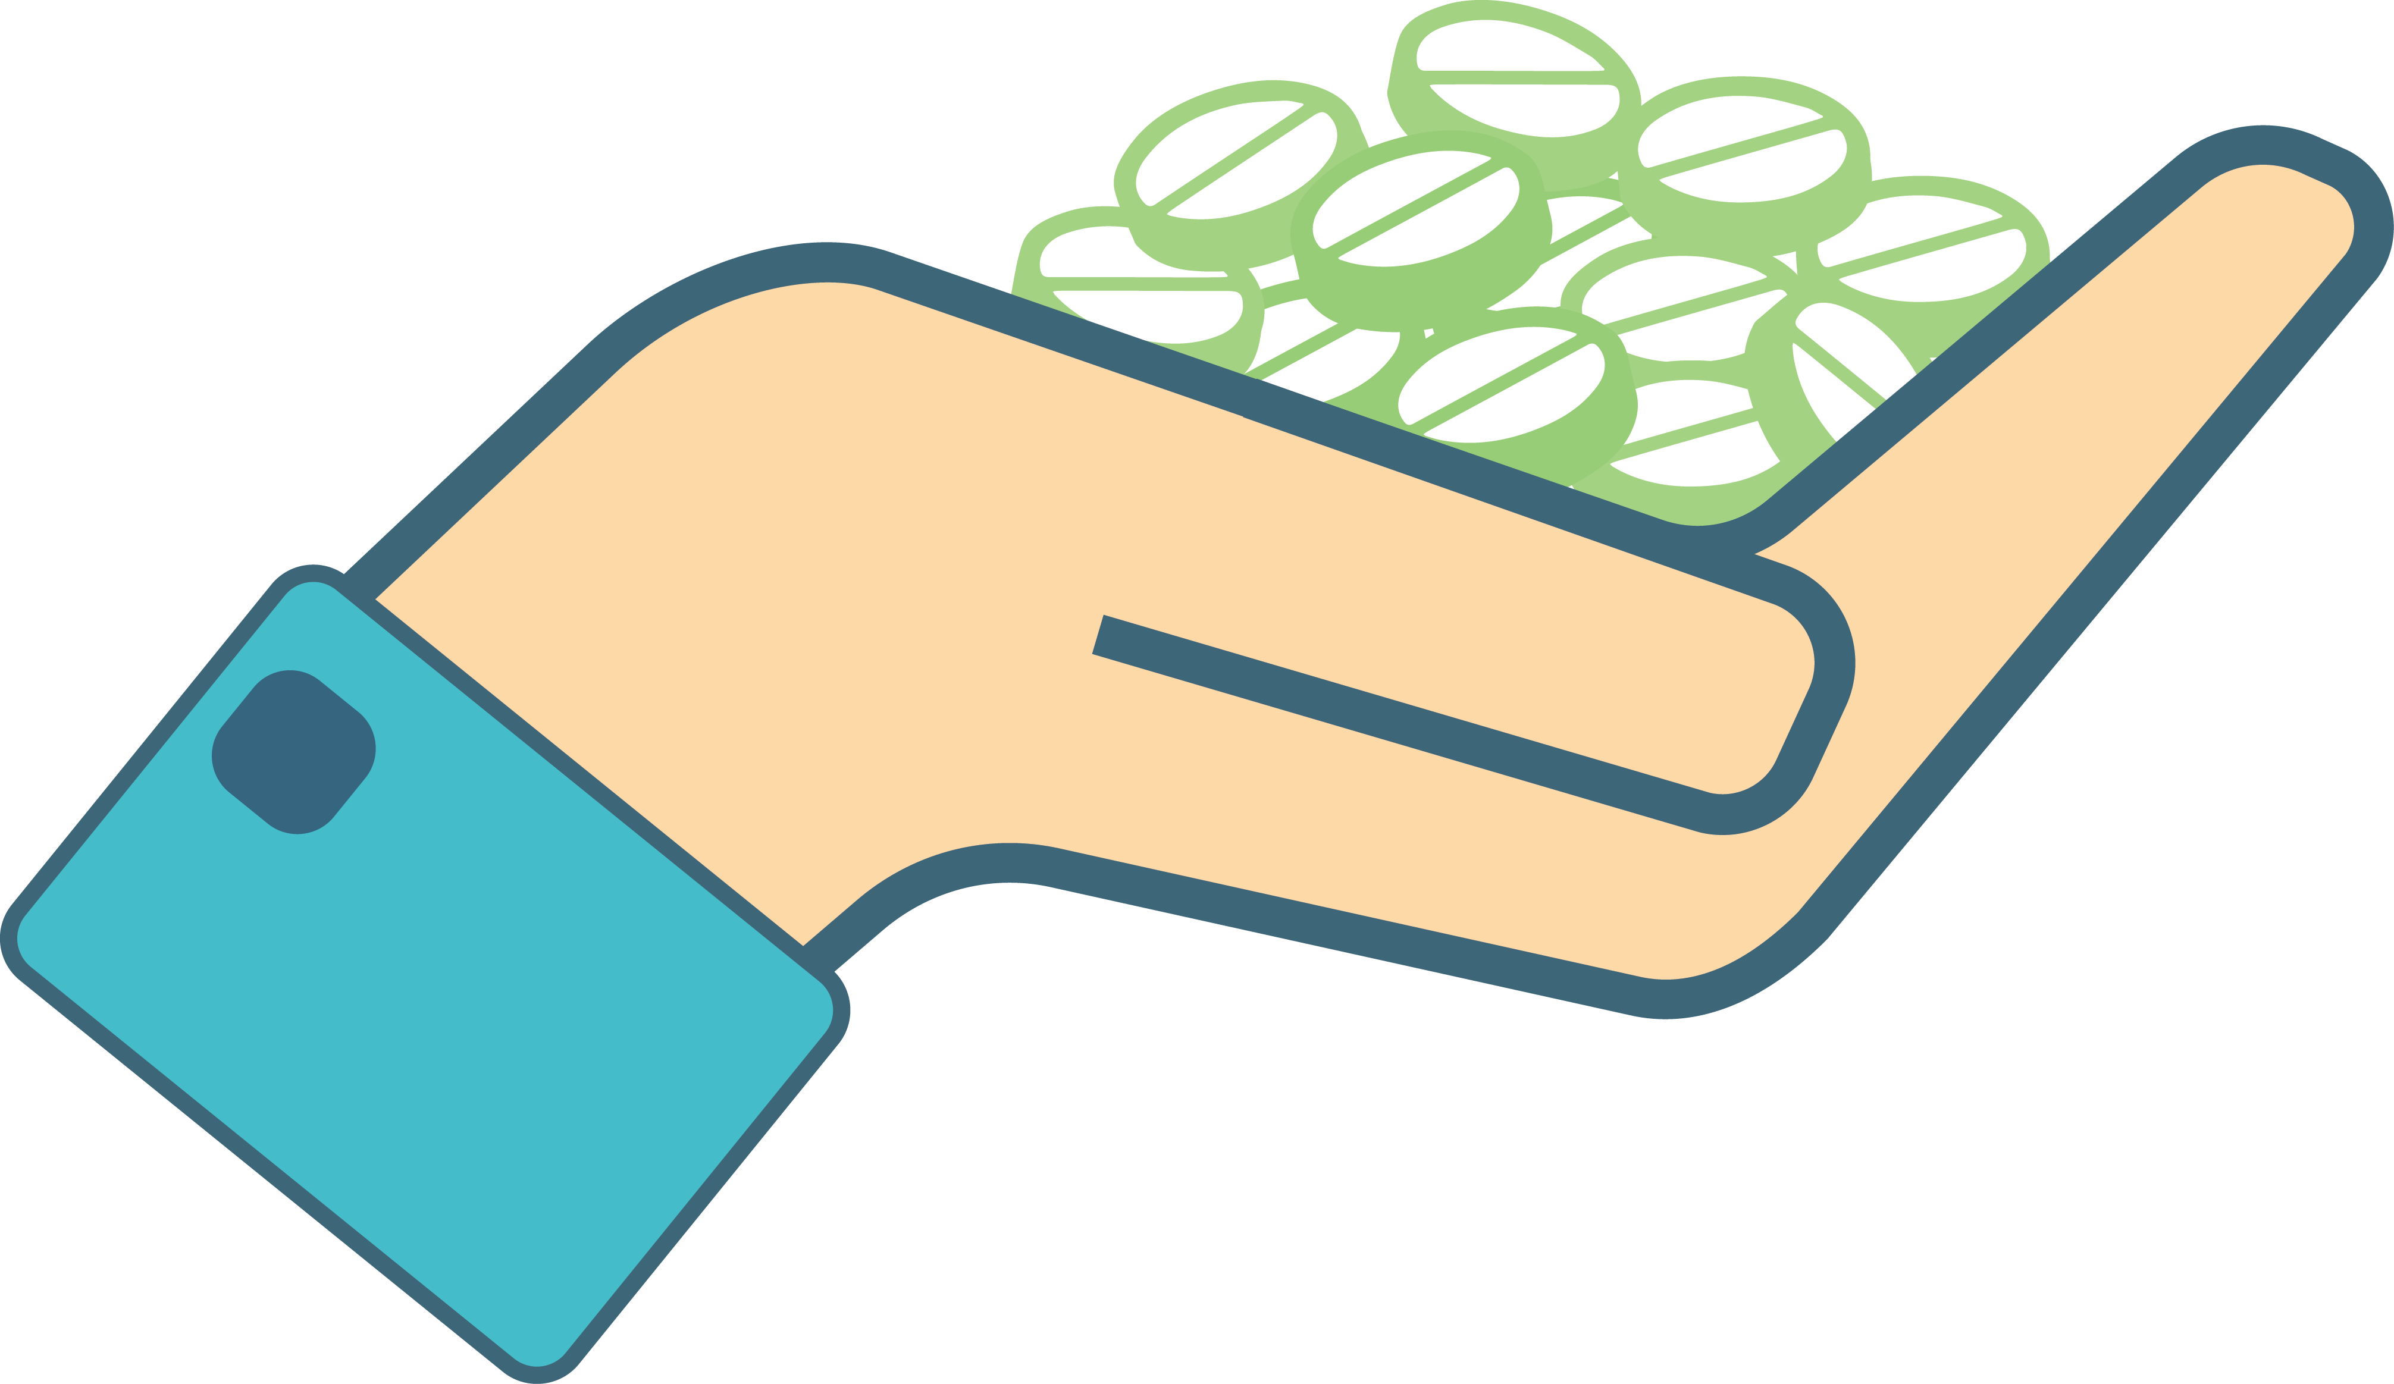
Which scenario represents prescription drug misuse?
Notes:
Transition: Before we move forward, let’s define “prescription drug misuse”.
Here are three scenarios. Scenario 1: an individual takes medication to help them study. Scenario 2: an individual prescribed an opioid pain medication is in severe pain—the patient takes more than instructed to manage their pain. Scenario 3: an individual shares their prescription medication with a friend.
Which scenario do you think represents prescription drug misuse? Note to facilitator: Encourage participants to discuss amongst themselves which scenario(s) represent prescription drug misuse. When ready, poll the audience.
Correct! Each scenario represents prescription drug misuse.
In Scenario 1, the individual is taking a medication for a different reason than prescribed (medications are not prescribed to aid in studying).
In Scenario 2, the individual is taking more of the medication than prescribed. It’s often the case that people misusing are not doing it on purpose. However, these actions can still be harmful.
Lastly, in Scenario 3, the individual is sharing their prescription medication with someone else. Even if your intention is to help a friend or family member, sharing prescription medication can be dangerous.

Slide 4

Misusing medications is:
Taking medication for a reason different than prescribed
Taking more than prescribed
Sharing or taking someone else’s medication
Regardless of intentions…
Notes:
Transition: Therefore, we define prescription drug misuse as engaging in primarily three behaviors.
Taking more of a prescription medication than prescribed.
Taking a prescription medication for a reason different than prescribed.
Sharing or taking someone else’s prescription medication.
And as we noted on the previous slide, regardless of our intentions, engaging in any of these behaviors is misuse.
Note for facilitator: If asked, the National Institute of Health drafted and currently supports these definitions of prescription drug misuse.

Slide 5
Do the majority of teens misuse prescription drugs?
NO!
5
Notes:
Transition: Now that we understand the behaviors that define misuse, what do you think?
Do the majority of teens misuse prescription medications?
Note to facilitator: Encourage participants to answer this question. When ready, click the space bar. The text bubble “No!” will appear.

Slide 6



Fact: 6 out of 7 teens do NOT misuse prescription drugs
6
Notes:
Transition: Actually, 6 out of 7 teens do NOT misuse prescription medications.
This suggests that only 1 in 7 teens, or roughly 15%, have misused prescription medications in the past year. Even fewer do so regularly. This certainly isn’t the majority!
Never feel like you are “not normal” or you won’t “fit in” with your peers if you don’t misuse…this simply isn’t true.
Note to facilitator: Across the leading national surveys, discrepancies exist amongst prevalence estimates. The statistic reported in this slide represents past year misuse from 2014 surveys (data collected in 2013), and is a conservative estimate based on the following data:
Past year misuse:
National Survey on Drug Use and Health: 6.2%
Monitoring the Future Study: 13.9%
The Partnership Attitude Tracking Study: 16%
The Partnership Attitude Tracking Study (2014) reports lifetime misuse amongst teens at 24%.

Slide 7

…yet prescription drug misuse remains a problem nationwide
Notes:
Transition: But what is true, is that prescription drug misuse remains a problem nationwide, including in many of our communities.
Drug overdose deaths, primarily from prescription medications, is the leading cause of accidental death in the U.S. Clearly misusing prescription medications can be harmful to your health. In addition, selling or taking someone else’s prescription medication is a felony offense and punishable by jail time.
The most commonly misused prescription drugs include opioid pain medications (e.g. Vicodin, OxyContin), sedatives (e.g., Xanax, Valium) and stimulants (e.g., Adderall, Ritalin)
Note to facilitators: what follows is a list of factors that fuel this problem. Based on your audience, you may wish to discuss these factors, or simply use the information to answer potential questions by participants.
Drug-taking Culture: We are a drug-taking society, and the use of medications has become normalized in our culture.
Easy Access: Because we are using medications at unprecedented rates, they are relatively easy to obtain without a prescription. In fact, data from the National Survey on Drug Use and Health demonstrates that the majority of individuals that misuse a prescription drug get them from family members or friends.
Misperceptions: There are many misperceptions surrounding the legality and safety of prescription drugs. For example, many of us don’t realize that it is illegal (and considered a felony offense for the types of medications which are most misused) to provide any prescription drug to another person without a legitimate prescription. Unfortunately, many individuals do not understand these dangers and thus don’t recognize that the misuse of many prescription drugs can be just as dangerous as using illicit “street” drugs.
Prescribing Practices: The number of prescriptions written by doctors has escalated, especially that for prescription opioids. In 2012, the CDC reported that physicians wrote over 250 million prescriptions for opioid medications (CDC, 2014).
Media: We are only one of two countries (other is New Zealand) that permit direct-to-consumer advertisements for prescription medications. These advertisements fuel our false beliefs that medications provide quick fixes to everyday problems.
Mixing Drugs: Misperceptions also exist regarding the dangers of mixing prescription medications with alcohol. Many overdoses result from mixing prescription medications with alcohol or with other drugs.
Pressures facing youth: Like adults, many youth misuse prescription medications to deal with various pressures they experience. Pressures may include managing daily stress and anxiety or perhaps pressure to perform at a high level either in athletics or in academics.
Issues of care: In some situations, healthcare professionals may not be educating patients on the safe use of the medications prescribed to them following a surgery or treatment of a medical condition. This lack of education can lead to misuse.

Slide 8
You CAN make a difference!
GOOD NEWS!
Notes:
Transition: The good news is that you can make a difference!
Note to facilitator: Consider allowing participants to brainstorm and share ideas on how they can make a difference. You may wish to summarize these ideas on a whiteboard, if available.

Slide 9
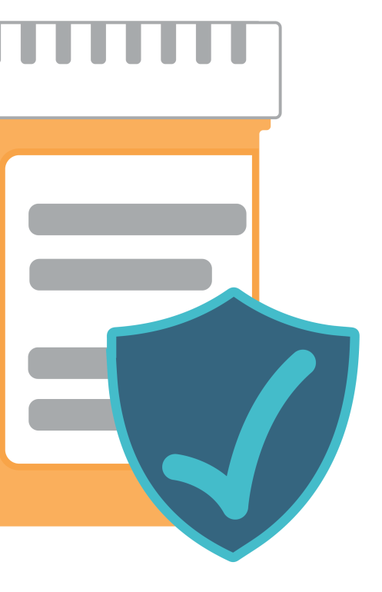
Use Medications Safely
Keep for yourself
Follow instructions
Be a good role model
9
Notes:
Transition: How can you make a difference?
You can easily make a difference by incorporating three safe medication practices into your daily life: Follow instructions, keep for yourself, serve as a good role model
Let’s discuss these practices in more detail. We’ll start with “keep for yourself”.

Slide 10

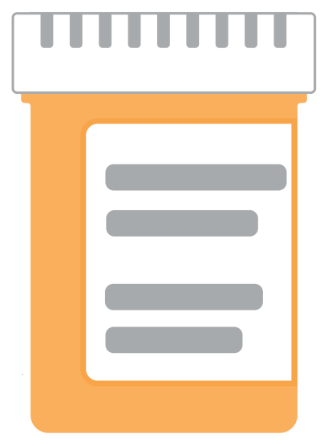
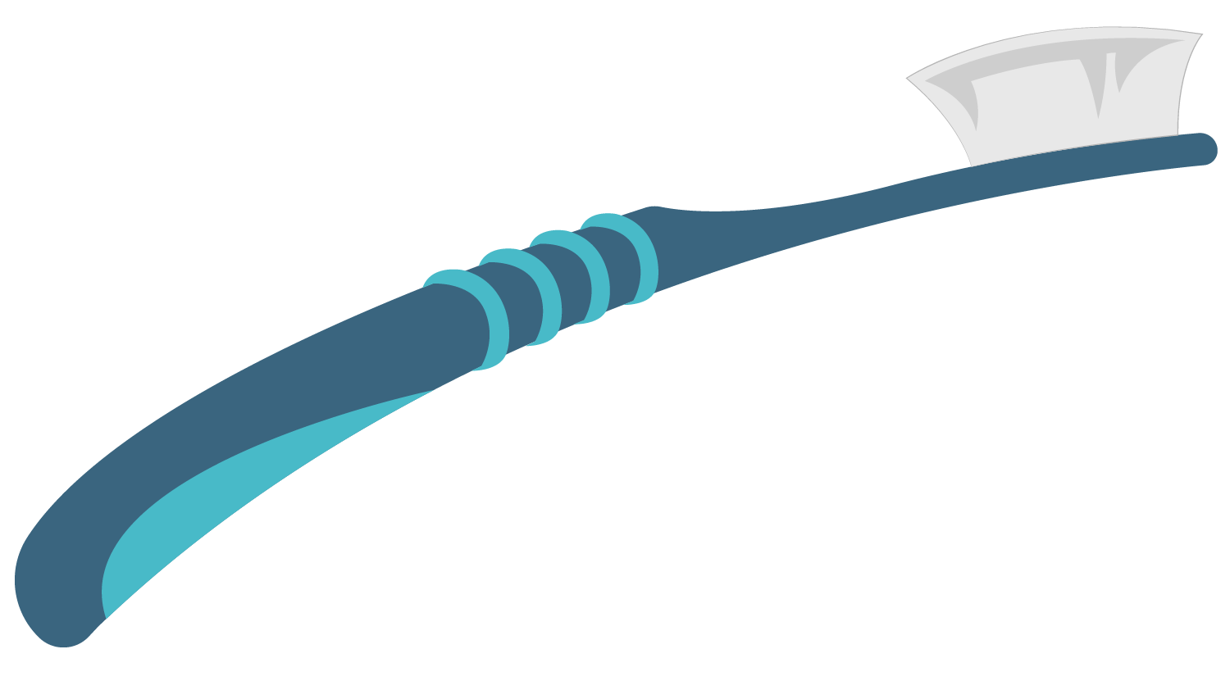
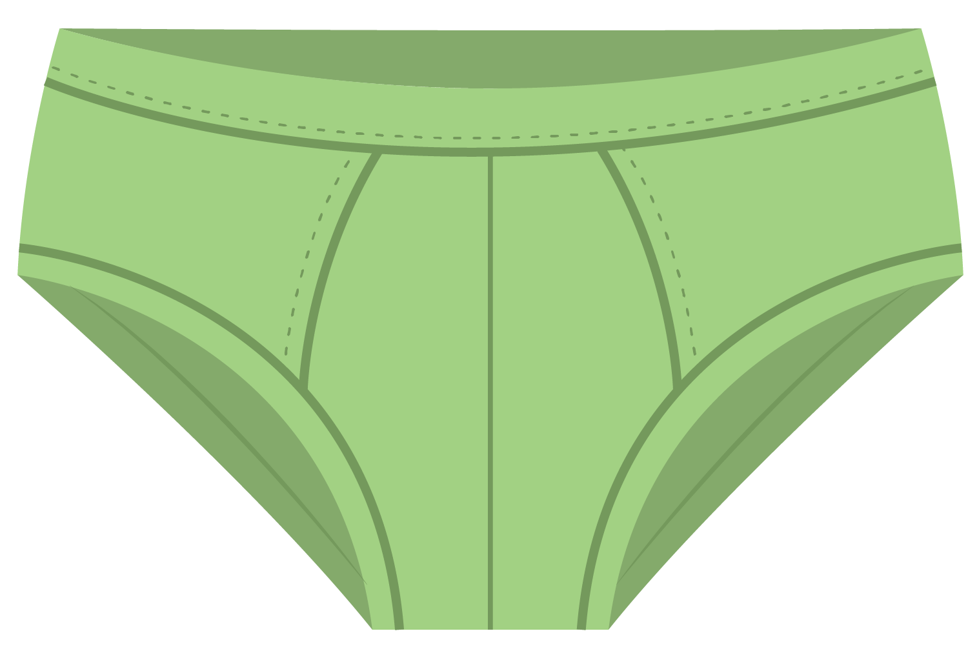
Some items aren’t meant to be shared…
10
Notes:
Transition: So some items aren’t meant to be shared…
Would you share your toothbrush or your underwear with someone? Yuck! Of course not!
Prescription medications aren’t any different. Prescription medications are intended to be used by the individual whose name is on the prescription—just like your underwear and toothbrush, prescription medications should be kept to yourself and not shared.
Why not? Why do you think we shouldn’t share medications? Note to facilitator: encourage participants to volunteer answers.
There are several reasons…our genetics, existing medical conditions, current medications we may be taking, even our age and weight, can all determine how we respond to medication. And that includes not only how we respond to the therapeutic effects, but also to the negative side effects that can be harmful. Genetic risk factors that increase the propensity to develop a physical dependency or addiction to a drug do exist—how your friend’s body handles a medication is not telling of how your body will handle the same medication.

Slide 11
Use Medications Safely
Keep for yourself
Follow instructions
Be a good role model
11
Notes:
Transition: In addition to keeping medications for yourself, we should also follow instructions and take prescription medications as instructed by a healthcare professional.
Let’s talk about this practice a little more…

Slide 12


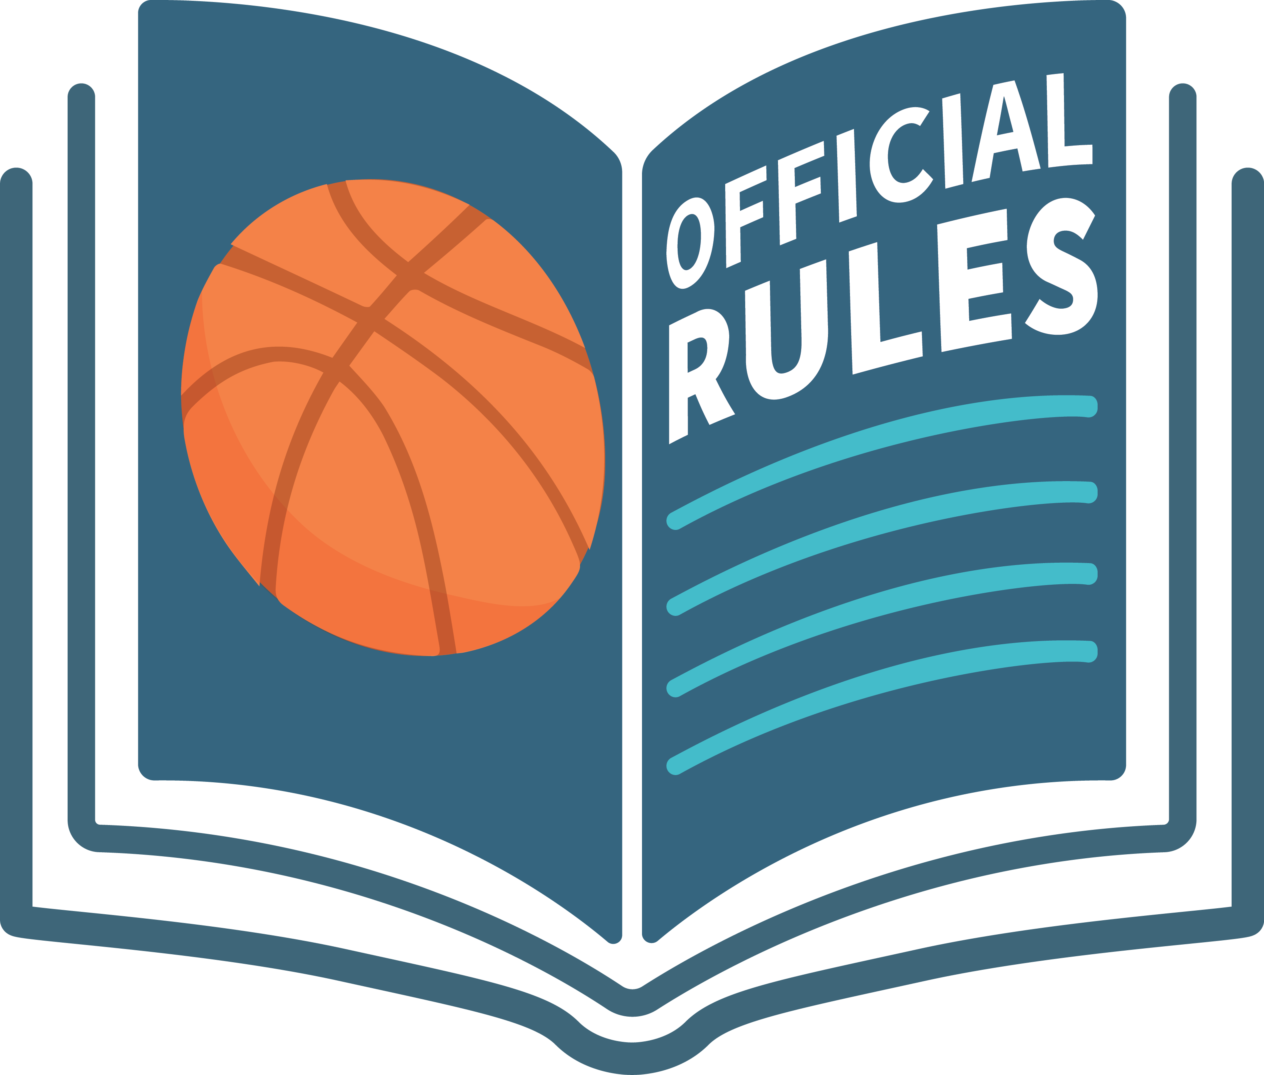
Some instructions are meant to be followed…
12
Notes:
Transition: So some instructions are meant to be followed.
When it comes time to apply for admission into a college or university, you’re likely going to read every instruction on that application. Why? Because failing to follow instructions may lead to an undesired consequence, like not being accepted to that university.
Likewise, athletes are required to play sports according to a set of rules—if they don’t follow the rules, they’re penalized.
Prescription medications are similar. When we don’t follow the instructions provided by the healthcare professional, undesired consequences can occur.

Slide 13

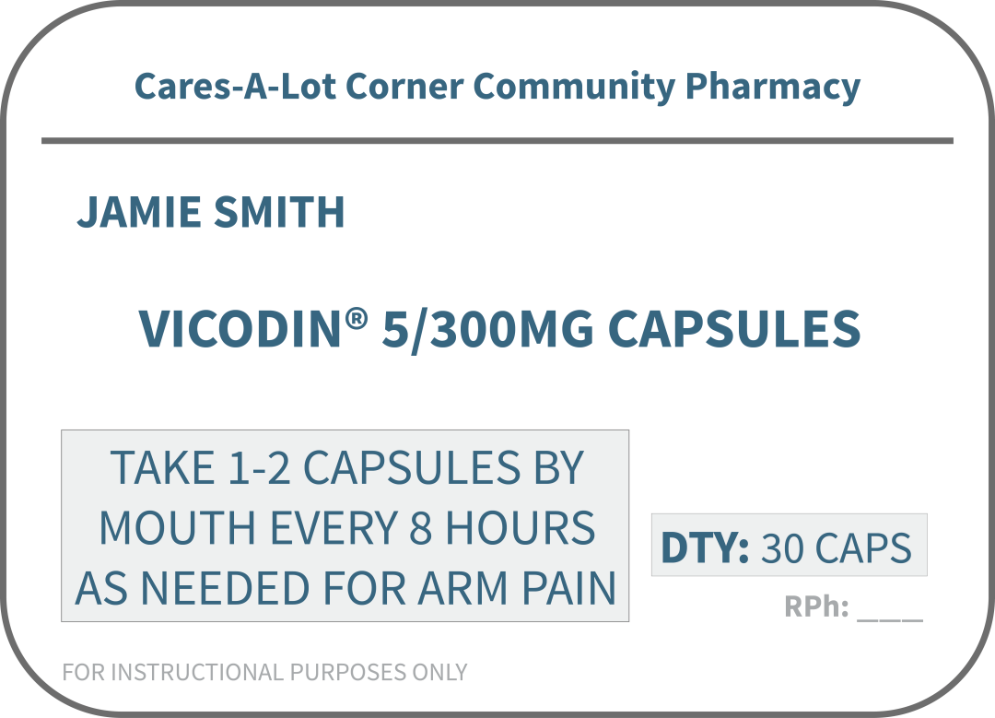
Why follow instructions?
1
How much & how often
2
Reason for medication
13
Notes:
Transition: You may be thinking, “but why?”. “Why do I need to follow instructions?”
Consider this prescription label for the opioid pain medication, Vicodin. As mentioned earlier, prescription opioid pain medications are among the most commonly misused prescription drugs. The instructions state: take 1-2 capsules by mouth every 8 hours as needed for arm pain.
Instructions on prescription medications consist of two parts: Part 1—how much of the medication (dose) and how often you take the medication (frequency); Part 2—the reason for taking the medication (indication). Some times the reason may not appear on the instructions, but the prescription was written by a doctor to provide a specific intended effect…like to relieve pain, in this example.
Instructions are provided to keep us safe. When we don’t follow instructions, we increase the likelihood that negative side effects, including developing a dependency on some medications, can occur.

Slide 14
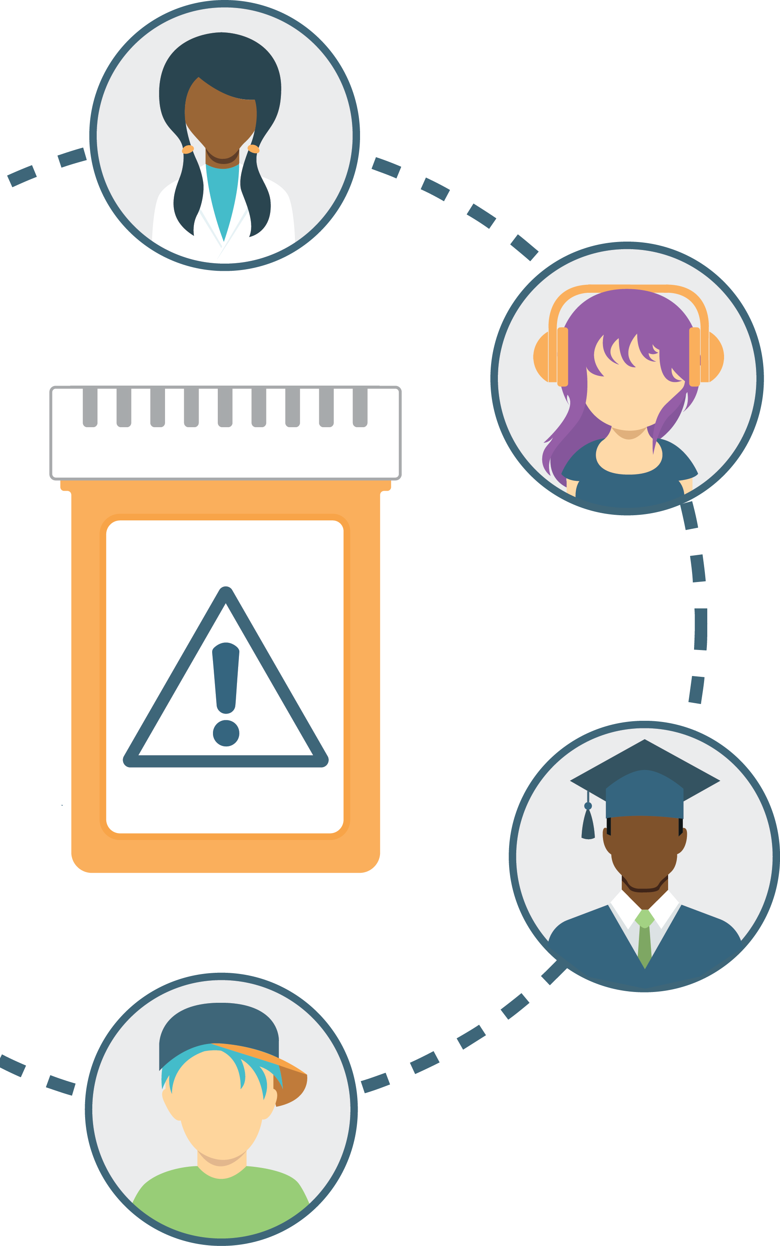

Think About It:
Some people misuse medication by taking it for a different reason than prescribed.
What reasons do teens give?
14
Notes:
Transition: Some people misuse prescription medications by taking them for a reason different than prescribed. What reasons do teens give for misusing prescription medications?
By yourself or working with a partner, brainstorm why teens misuse prescription medications. I’ll give you a few minutes to do this.
Note to facilitator: encourage each team to share one reason with the entire group. You may wish to list these reasons on a whiteboard or a large sheet of paper for all participants to see. Possible reasons include:
To manage stress
To improve academic performance or help in school
To cope with feelings of depression
To deal with a physical injury in order to perform in an athletic event (“play through the pain”)
To have fun
To have something to do (i.e. boredom) or try something new (i.e. curiosity)

Slide 15

Think About It:
What could teens do instead of misusing?
Identify a few positive alternatives.
15
Notes:
Transition: Now that we’ve identified common reasons for misusing, let’s consider some positive alternatives.
Note to facilitator: Encourage participants to brainstorm positive alternatives for the identified reasons. Consider listing these alternatives next to your list of “reasons” on the same whiteboard.
Below are talking points for some alternatives that teens might suggest.
To help with school: it may be tempting to misuse prescription drugs as a “quick fix” to help you cram for an upcoming exam. However, this isn’t a sustainable approach for earning good grades. Try studying with friends, work with a tutor, or meet with your teacher before or after school.
To cope with depression: if your mood feels depressed, confide in a trusted adult. Resorting to misusing prescription medications or using other substances will only prolong your feelings of depression.
To deal with an injury: if you are an athlete experiencing an injury, you may feel pressure to “play through the pain”. However, the possible consequences from misusing a prescription opioid pain medication are far more devastating than not performing in an athletic event. If you are dealing with an injury, work with an athletic trainer or a healthcare professional to safely plan your recovery.
To handle boredom: boredom can affect all of us…try curing your boredom by engaging in something you enjoy (like art, sports, helping others, etc).
To handle stress: stress will always be present in life. Try adopting healthy habits for dealing with stress like exercising, watching TV or a movie, or taking a nap.

Slide 16
Use Medications Safely
Keep for yourself
Follow instructions
Be a good role model
16
Notes:
Transition: Let’s recap…you can make a difference and prevent prescription drug misuse by keeping medications for yourself, following instructions, and lastly by being a good role model. This includes modeling these practices at home, and encouraging your family and friends to do the same.

Slide 17
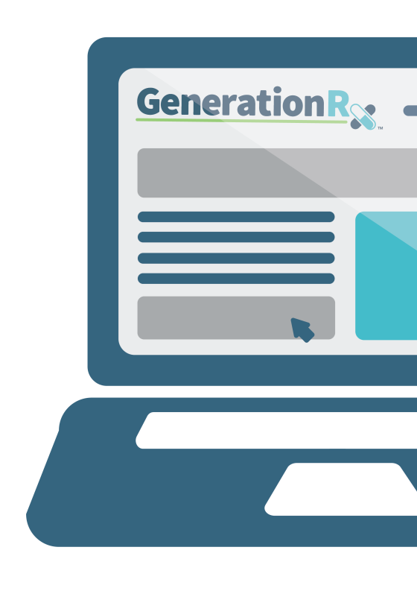
Help Others
Learn more
Share the information
Talk with a trusted adult
Visit: GenerationRx.org
Notes:
Transition: In addition to serving as a good role model, we encourage you to share this information and help others. How can you help others?
First, you (and other adults) can learn more about this issue by visiting the ‘Learn’ section on GenerationRx.org.
Second, you can share these messages with others. This may consist of discussing these messages with family and friends, or sharing these messages through peer-to-peer education. Visit our website, GenerationRx.org, to access free, ready-to-use resources designed to educate teens. You could present this program, or a different activity. You could also present similar educational programs to other audiences, like young children, using our age-appropriate resources.
Lastly, if you are concerned about someone you care about, we encourage you to talk to a trusted adult. In addition, we’ve identified additional resources for helping others on GenerationRx.org.
Note to facilitator: you may consider assisting teens with identifying adults they can discuss concerns with, as well as providing local resources where teens or adults can find help.

Slide 18


Brought to you by:
Notes:
Transition: Does anyone have any questions or comments?
Before we end, we encourage you to stay connected by following us @MyGenerationRx (Twitter) and MyGenerationRx on Instagram.
Also, we encourage you to take a survey evaluating today’s program on generationrx.org. You can find a link to this survey at the bottom of the home page. We value your feedback to help us assess the impact of this work and continually improve Generation Rx materials.
Note to facilitator: we encourage you, as the presenter, to also complete this survey. Thank you for advocating safe medication practices in your community!
We also encourage you to share your experience with us. Consider submitting your tips and personal experiences about how you advocate safe medication practices at home or in your community. To do this, visit the ‘Contact’ section of GenerationRx.org. In this same section, you can also submit any questions you may have regarding how to use these educational resources.

